Slide 1
LBC59 (ch 26 HG) and EBC16 (ch 36 LG, ch 39 HG) are now well calibrated, modules turned to green
unfortunately more modules show problems now
LBA35 ch 8 HG (Amp/Q now 1.4)
LBC47 ch 15 LG (Amp/Q now 1.2) ********
LBC57 ch 6 HG (Amp/Q now 1.5)
EBA61 ch 15 HG (Amp/Q now 0.93, maybe at threshold with original calib?)
EBA64 ch 3 HG (Amp/Q now 0.5)
EBC61 ch 8 LG (Amp/Q now 1.2)
why the calibration did not improve EBA50 ch 31 HG, EBC18 ch 36 HG?
EBA07 ch 31 LG overcalibrated now (Amp/Q 1.2 → 0.9)
CIS calibration must be double checked and updates discussed with DQ team

Slide 2
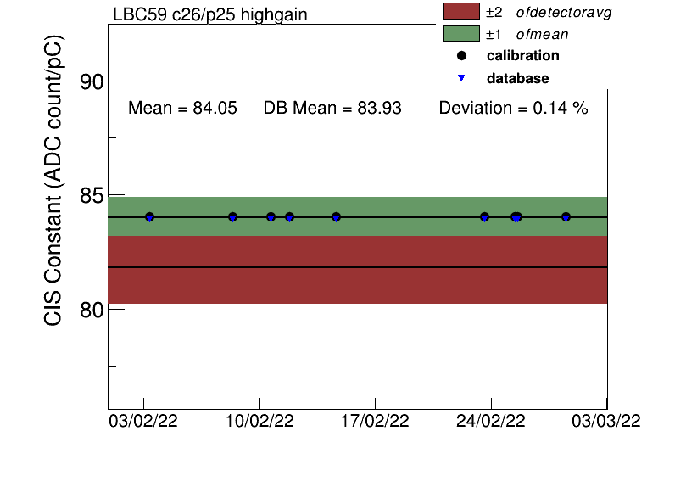

Slide 3
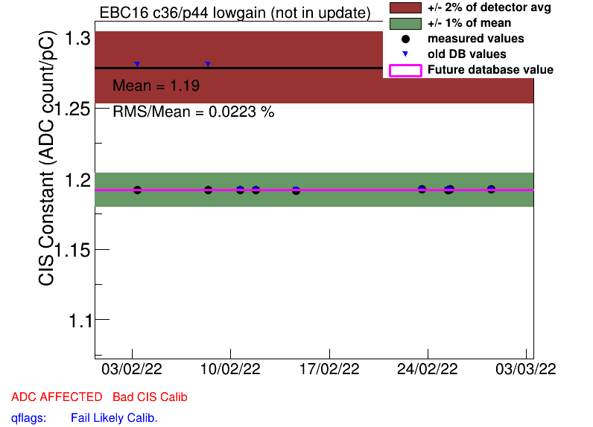

Slide 4
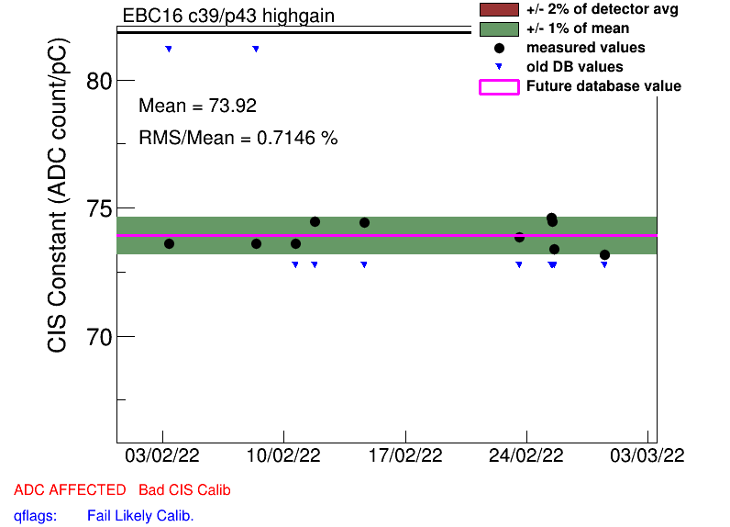

Slide 5
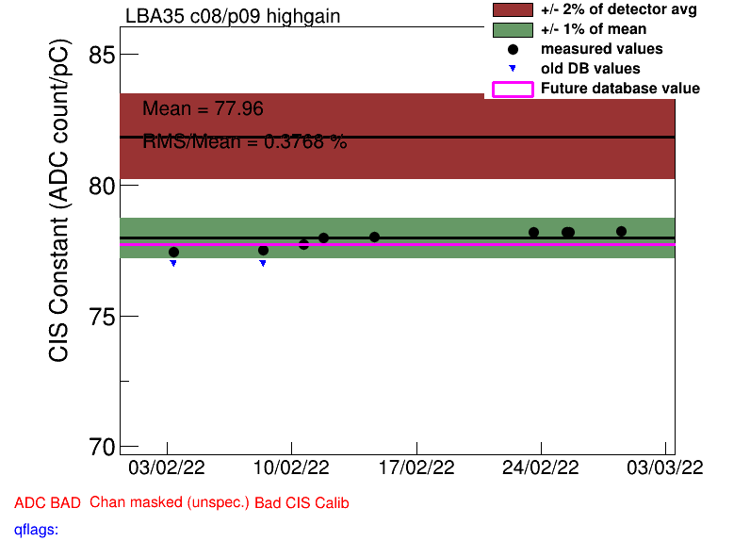

Slide 6
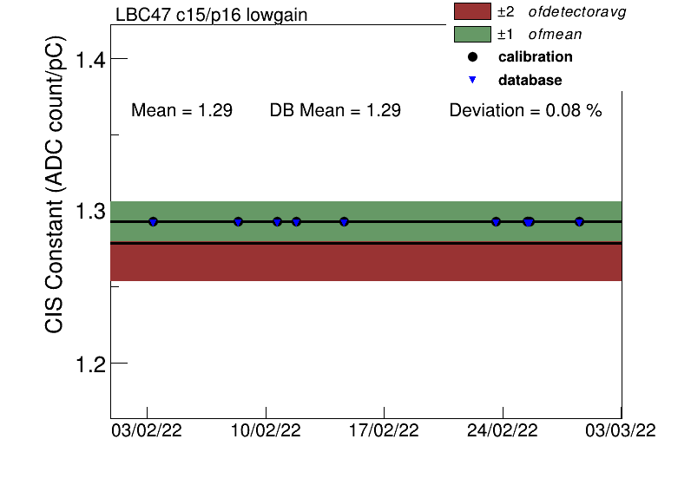

Slide 7
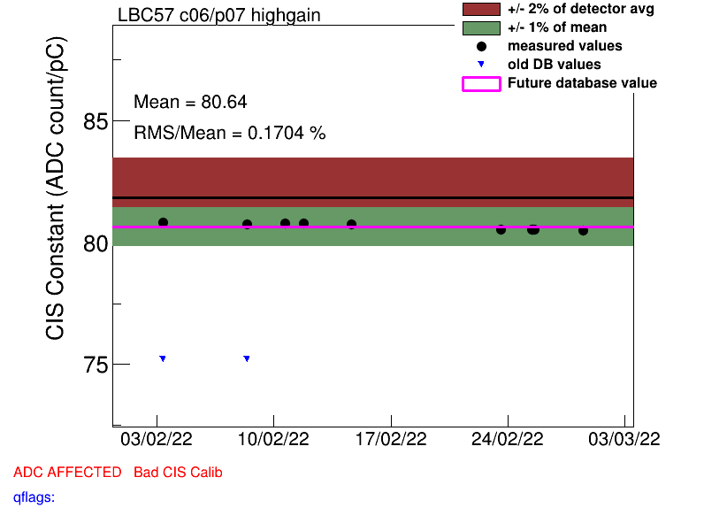

Slide 8
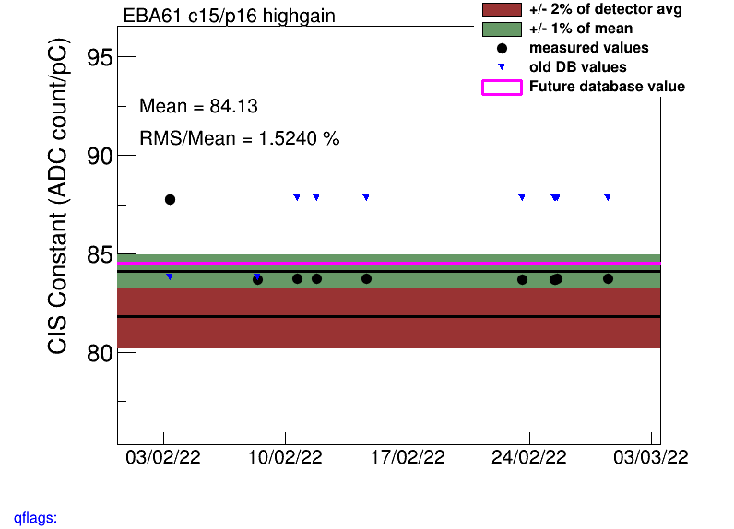

Slide 9
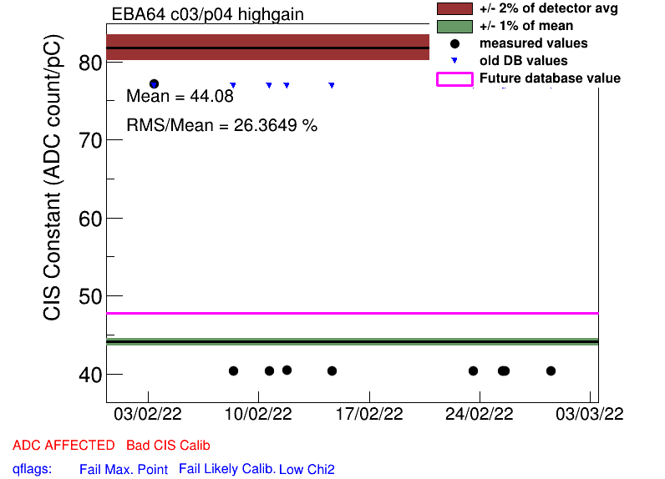

Slide 10
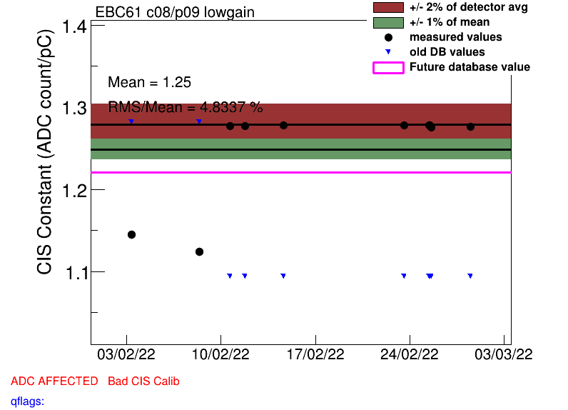

Slide 11
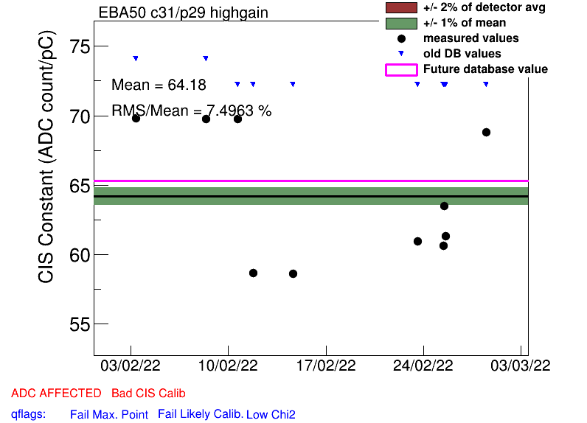

Slide 12
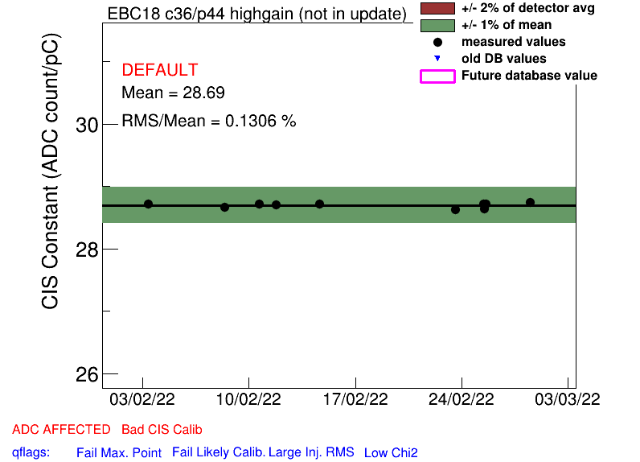

Slide 13
